Slide 1
OOP
WEEK06 MUHAMMAD NAEEM AKHTAR

Slide 2
Contents
06 | Operator = (assignment statement) Operator overloading +, -, *, /, [] Operator Overloading - unary operator (+, - , ++, --) Operator Overloading continued (==, >=, <=, ==) Stream Insertion << , Stream Extraction >> | Text Book Chapter: 11 | Assignment: 02

Slide 3
Operator Overloading in C++
In C++, we can make operators work for user-defined classes.
This means C++ has the ability to provide the operators with a special meaning for a data type, this ability is known as operator overloading.
For example, we can overload an operator ‘+’ in a class like String so that we can concatenate two strings by just using +.
Other example classes where arithmetic operators may be overloaded are Complex Numbers, Fractional Numbers, Big Integer, etc.

Slide 4
Operator Overloading in C++
Operator overloading is a compile-time polymorphism.
It is an idea of giving special meaning to an existing operator in C++ without changing its original meaning.
Example:
int a; float b,sum; sum=a+b;
Here, variables “a” and “b” are of types “int” and “float”, which are built-in data types. Hence the addition operator ‘+’ can easily add the contents of “a” and “b”. This is because the addition operator “+” is predefined to add variables of built-in data type only.

Slide 5
Operator Overloading in C++
Now, consider another example
class A {
//somecode
};
int main() { A a1,a2,a3; //error
a3= a1 + a2;
return 0; }
Notes:
In this example, we have 3 variables “a1”, “a2” and “a3” of type “class A”. Here we are trying to add two objects “a1” and “a2”, which are of user-defined type i.e. of type “class A” using the “+” operator. This is not allowed, because the addition operator “+” is predefined to operate only on built-in data types. But here, “class A” is a user-defined type, so the compiler generates an error. This is where the concept of “Operator overloading” comes in. Now, if the user wants to make the operator “+” to add two class objects, the user has to redefine the meaning of the “+” operator such that it adds two class objects. This is done by using the concept “Operator overloading”. So the main idea behind “Operator overloading” is to use c++ operators with class variables or class objects. Redefining the meaning of operators really does not change their original meaning; instead, they have been given additional meaning along with their existing ones.

Slide 6
Example
Overloaded operator function can be member function of class or friend function.
Overloading + operator
Syntax
Return_type Class_Name :: operator symbol (argument list)
Box operator+(const Box&)
See operator_overloading_plus1,2.cpp
Classname obj3=obj1+obj2
Compiler calls: obj4=obj1.operator+(obj2)

Slide 7
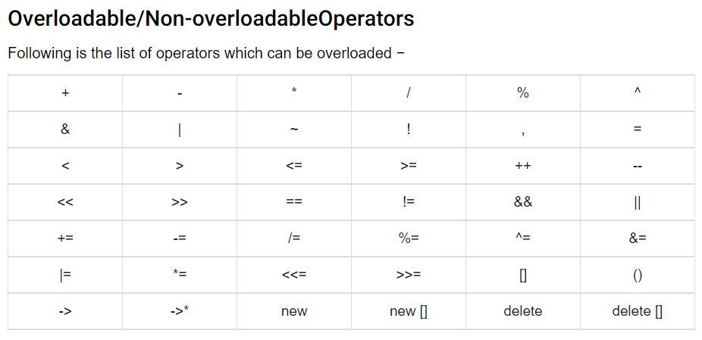
List of Operators Possible to Overload

Slide 8
List of Operators Can not be Overloaded
sizeof typeid
Scope resolution (::)
Class member access operators (.(dot), .* (pointer to member operator))
Ternary or conditional (?:)
Reading Assignment: Why we cannot overload above operators.

Slide 9
Rules for Operator Overloading
In C++, following are the general rules for operator overloading.
Only built-in operators can be overloaded. New operators can not be created.
Arity of the operators cannot be changed.
No. of operand an operator takes.
3) Precedence and associativity of the operators cannot be changed.
Precedence: a+b*c=b*c+a
Associative: a+b+c+d(left to right associcative)
4) Overloaded operators cannot have default arguments except the
function call operator () which can have default arguments.

Slide 10
Rules…
Operators cannot be overloaded for built in types only. At least one operand must be used defined type.
Assignment (=), subscript ([]), function call (“()”), and member selection (- >) operators must be defined as member functions
Except the operators specified in point 6, all other operators can be either member functions or a non member functions.
Some operators like (assignment)=, (address)& and comma (,) are by default overloaded.
Do not change natural behavior of an operator.

Slide 11
Binary operators
Overloading + operator:
class Complex{
private:
double real, img;
public:
…
Complex operator +(const Complex & rhs);
};

Slide 12
Binary operators
Complex Complex::operator +( const Complex & rhs){
Complex t;
t.real = real + rhs.real;
t.img = img + rhs.img;
return t;
}

Slide 13
Binary operators
The return type is Complex so as to facilitate complex statements like:
Complex t = c1 + c2 + c3;
The above statement is automatically converted by the compiler into appropriate function calls:
(c1.operator +(c2)).operator +(c3);

Slide 14
Binary operators
The binary operator is always called with reference to the left hand argument
Example:
In c1+c2, c1.operator+(c2)
In c2+c1, c2.operator+(c1)

Slide 15
Binary operators
The above examples don’t handle the following situation:
Complex c1;
c1 + 2.325
To do this, we have to modify the Complex class

Slide 16
Binary operators
Modifying the complex class:
class Complex{
...
Complex operator+(const Complex & rhs);
Complex operator+(const double& rhs);
};

Slide 17
Binary operators
Complex operator + (const double& rhs){
Complex t;
t.real = real + rhs;
t.img = img;
return t;
}

Slide 18
Binary operators
Now suppose:
Complex c2, c3;
We can do the following:
Complex c1 = c2 + c3;
and
Complex c4 = c2 + 235.01;

Slide 19
Binary operators
But problem arises if we do the following:
Complex c5 = 450.120 + c1;
The + operator is called with reference to 450.120
No predefined overloaded + operator is there that takes Complex as an argument

Slide 20
Binary operators
Now if we write the following two functions to the class, we can add a Complex to a real or vice versa:
Class Complex{
…
friend Complex operator + (const Complex & lhs, const double & rhs);
friend Complex operator + (const double & lhs, const Complex & rhs);
}

Slide 21
Binary operators
Complex operator +(const Complex & lhs, const double& rhs){
Complex t;
t.real = lhs.real + rhs;
t.img = lhs.img;
return t;
}

Slide 22
Binary operators
Complex operator + (const double & lhs, const Complex & rhs){
Complex t;
t.real = lhs + rhs.real;
t.img = rhs.img;
return t;
}

Slide 23
Binary operators
Class Complex{
…
Complex operator + (const Complex &);
friend Complex operator + (const Complex &, const double &);
friend Complex operator + (const double &, const Complex &);
};

Slide 24
Binary operators
Other binary operators are overloaded very similar to the + operator as demonstrated in the above examples
Example:
Complex operator * (const Complex & c1, const Complex & c2);
Complex operator / (const Complex & c1, const Complex & c2);
Complex operator - (const Complex & c1, const Complex & c2);

Slide 25
Binary operators
See example: operator_overloading_plus2,3,4.cpp

Slide 26
Subscripting [] Operator Overloading in C++
lvalue and rvalue?
See example: array_example1.cpp
Following are some useful facts about overloading of []. 1) Overloading of [] may be useful when we want to check for index out of bound. 2) We must return by reference in function because an expression like “arr[i]” can be used an lvalue.
See example: operator_overloading_[]_1,2.cpp

Slide 27
Unary Operator Overloading
unary operator (+, - , ++, --)
See operator_overloading_minus1.cpp
operator_overloading_pre++_1.cpp

